Slide 1
National Rural Employment Guarantee Act (NREGA) Analysis
Tool used : Power BI
Presented by Saravanan R
Date : 21-06-2024

Slide 2
Agenda
Introduction
Problem Statement
Effectiveness of NREGA scheme
Region Disparity
Budget Utilization and Correlate to Employment generate
Key factor contribute to NREGA work completion
Policy Maker and Administrator Insights
Action Insights
Data driven Recommendation

Slide 3
Introduction
Objective: Our main objective of this project analysis is gain valuable insights into the implementation and impact of NREGA across different states and districts in India.
Dataset: Dataset for analysis obtain from NGREA_Dataset.CSV, which was provide by mentorness. The dataset used for this analysis encompasses a wide range of parameters, including the number of job cards issued, the workforce engaged, budget allocation, work completion statistics, and much more.
Tool used: Power BI

Slide 4
Problem Statement
● How effective is NREGA in providing employment opportunities to rural households?
● Are there regional disparities in the implementation and outcomes of the scheme?
● What is the utilization of the allocated budget, and how does it correlate with
employment generation?
● What are the key factors contributing to the completion of NREGA works, and are there
any roadblocks to its success?
● Can data-driven insights guide policymakers and administrators in optimizing the
scheme's impact?

Slide 5
EFFECTIVENESS OF SHCEME

Slide 6
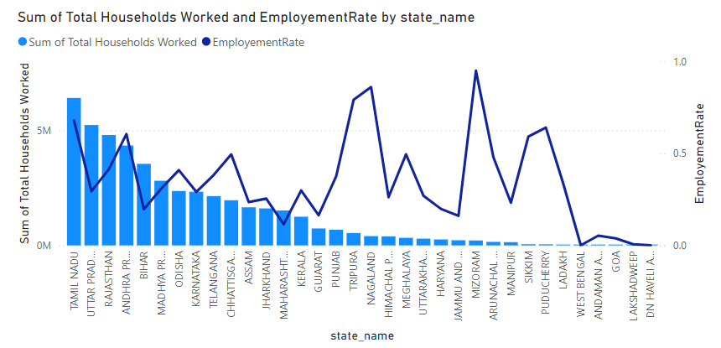
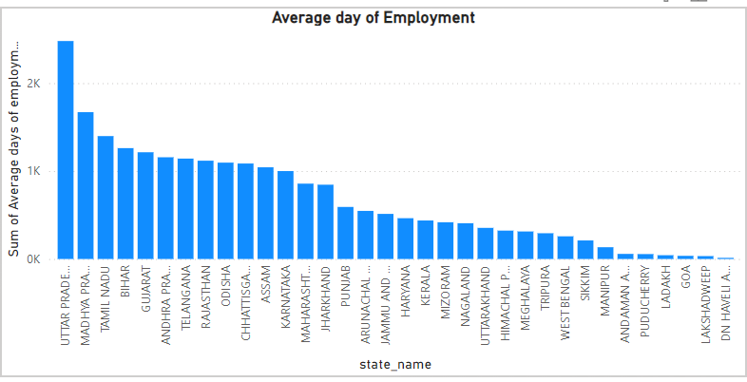
Employment Rate is Total household divided by number of job cards issued.
Effectiveness of NREGA act, we can see in these graphs
1) Graphs gives the average days of employment provide per household state wise gives an insights of UP state followed by Madhya Pradesh and Tamil Nadu have highest number average days per household.
2) The state of Tamil Nadu, Uttar Pradesh and Rajasthan have highest number of total household workers.

Slide 7
REGION WISE DISPARTIY

Slide 8
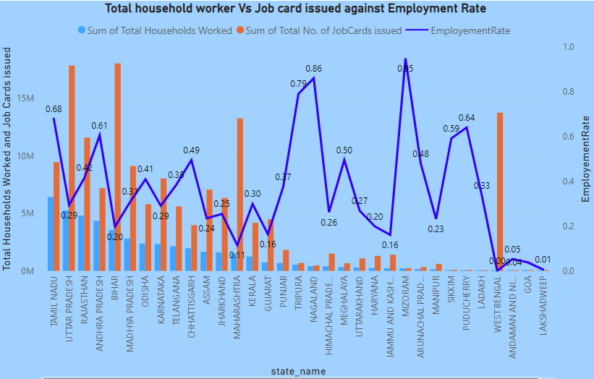
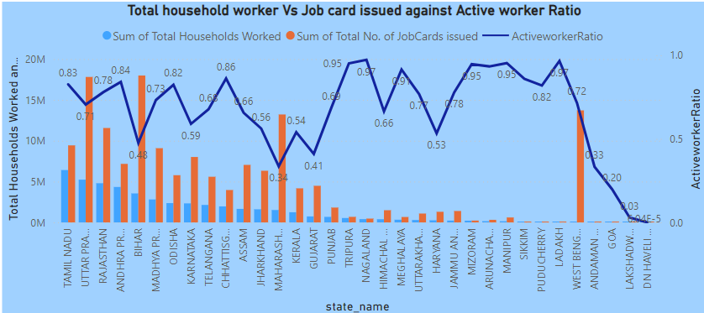
House hold Worker Vs Job Card issues
Employment rate against household workers and Job cards issues, this graph shows employment rate commending at states like Mizoram and Tripura but number of household worker is less.
Tamil Nadu followed by Andhra Pradesh performed excellent in terms of both household workers and number of job cards issued along with decent employment rate.
Active worker Ratio can be calculated by Number of active worker by Number of total worker.
When Job card issued less with household worker state have great Active worker Ratio and Employment rate

Slide 9
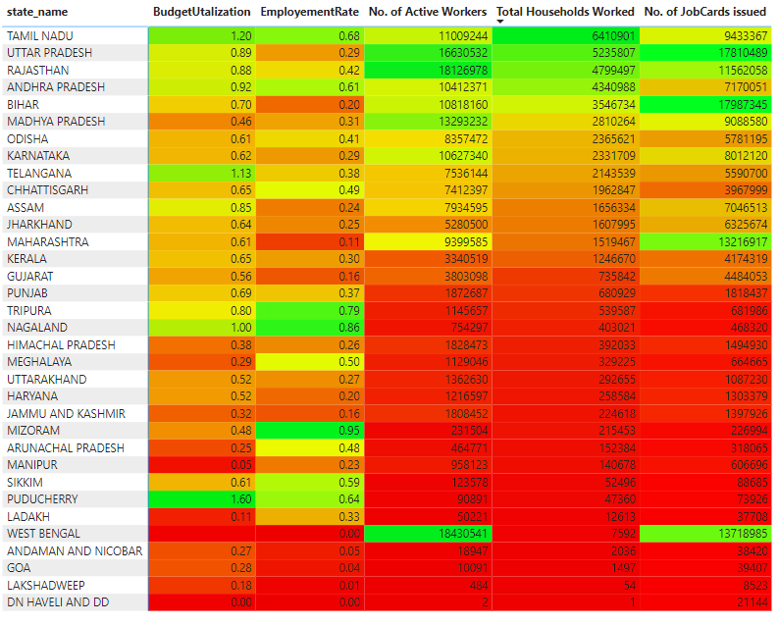
State wise performance
States likes TN, Andhra Pradesh and UP, Rajasthan have performed well when compare to other state.
West Bengal is outlier in this heatmap, because of No. of. Job cards issued were high and No. of. Active worker were engage in NREGA scheme were high but number of household worker involved in scheme is low, because of that Employment rate and Active worker ratio low.
Union Territory region perform low in all areas.

Slide 10
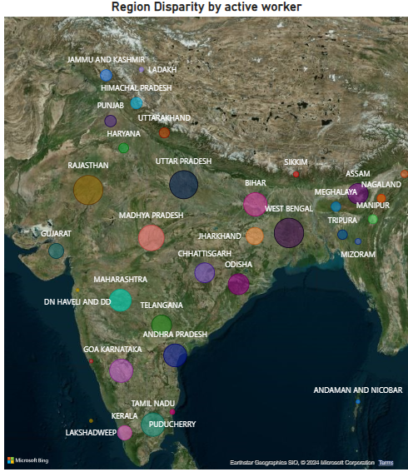
Region Disparities
South Region performed well in NREGA scheme when compare to other regions.
Central region functioning second best region.
Disparity can be see from Indian disparity map that shows North region and North East region performed low when compare to other regions.
Union territory region also operating low.

Slide 11
BUDGET UTILIZATION AND CORRELATE TO EMPLOYMENT

Slide 12
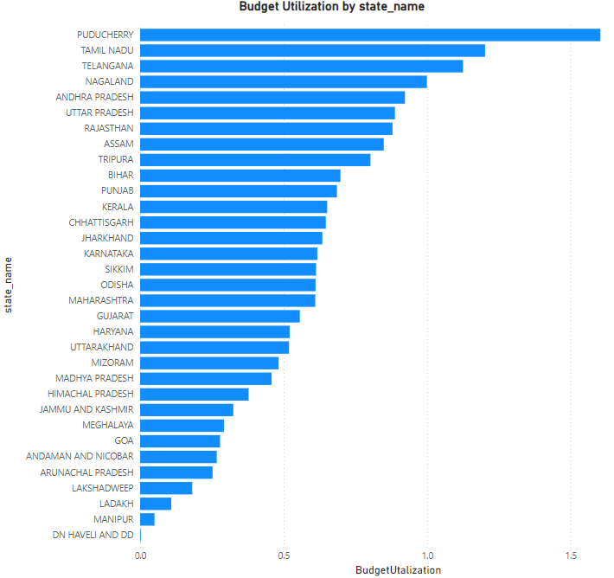
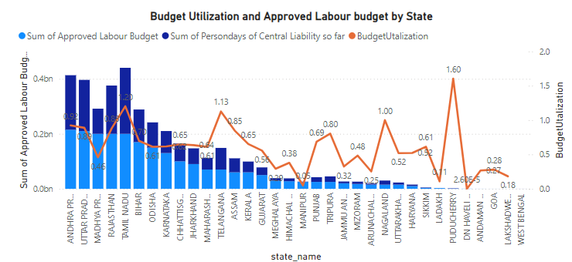
Budget Utilization
Budget Utilization can measure by person days of central liability so far by approved labour budget.
Puducherry have better budget utilization followed by Tamil Nadu, Telangana and Nagaland.

Slide 13
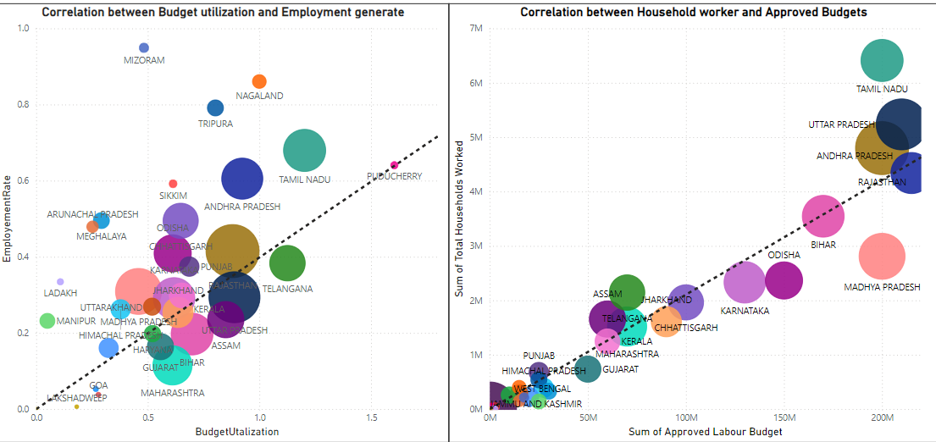
Correlation
From the scatter plot, Budget allocation and Utilization is correlate to Employment ratio. It gives insights that no of data point near to ratio line is cluster in that area. Ratio line above states shows with good utilization of budget performed well in Employment rate.
Budget allocation(Approved labour budget) is directly affect the employment generation.

Slide 14
KEY FACTOR CONTRIBUTE TO NREGA WORK COMPLETION

Slide 15
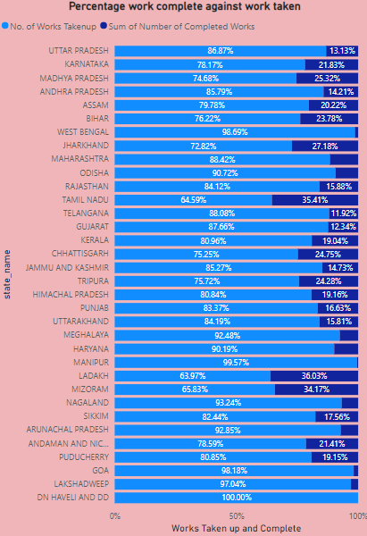
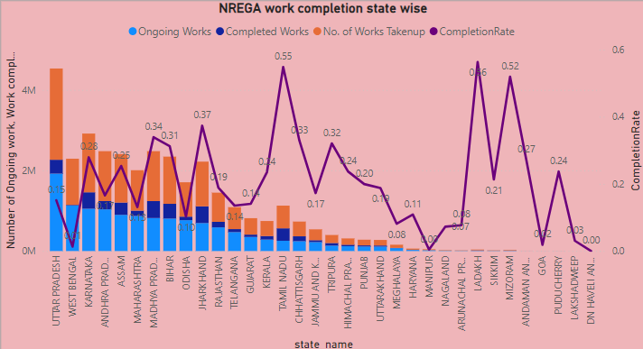
Work Completion
Completion rate can be calculated by Number of work complete by number of work taken.
Ladakh have high percent of work completion of work taken followed by Tamil Nadu and Mizoram.
North East region have low work completion percentage and work completion rate.

Slide 16
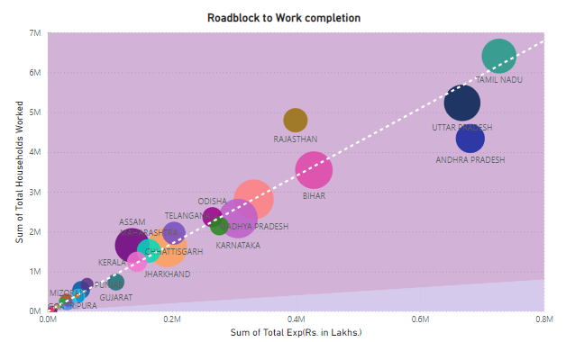
Road block to work completion
In scatter plots, When expenditure is low directly affect the number of work completion.
Expenditure and number of household workers is co-relate to number of work completion.
State with low household worker have least number of work completion.
Bubble size is number of work completion, as you can see least household worker has small bubble size and high household worker and expenditure has big bubble size.

Slide 17
POLICY MAKER AND ADMINISTRATOR INSIGHTS

Slide 18
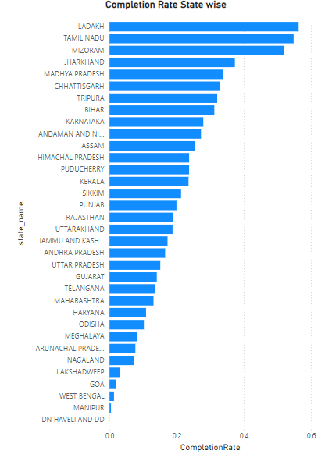
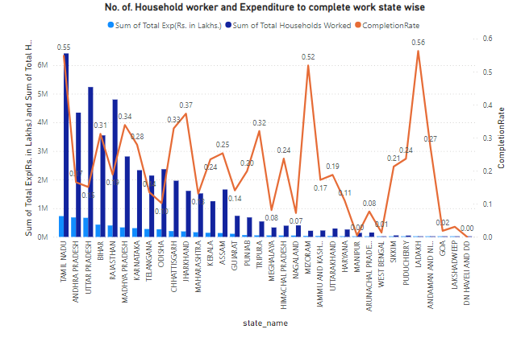
Policy Maker and Administrator Insights
Policy maker and administrators insight, key factors to be consider are Total expenditure, Total household workers, Completion Rate, On going works and Completed works.
Tamil Nadu State have excellent completion rate along with decent expenditure followed by Jharkhand and Bihar.

Slide 19
ACTION INSIGHTS AND RECOMMENDATION

Slide 20
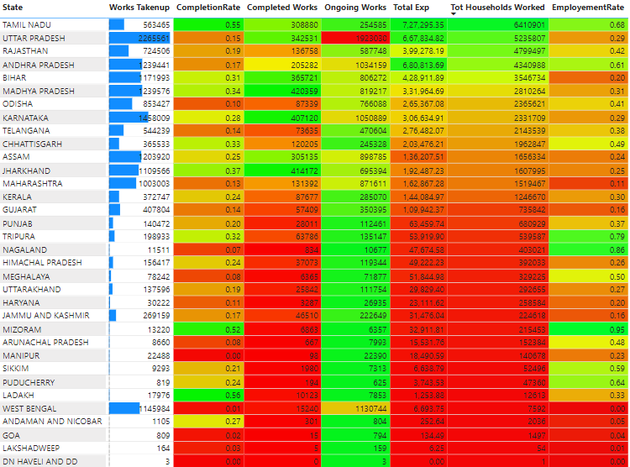
State performance for Action insights

Slide 21

Recommendation
From the table, you can see States like Tamil Nadu, Andhra Pradesh performed well.
Top 5 overall performed Stated in term of key metric are TN, Andhra Pradesh, UP, Bihar, Madhya Pradesh and Karnataka
South Region and Central Region performed excellent in all categories when compare to other regions and Allocate potential budget to south and central regions.
North region and North east region along with union territories need to improve in performance.

Slide 22
Thank you

